Slide 1
Adobe Connect: A Quickstart Guide

Slide 2
Before Joining The Meeting
Ensure you have a working laptop or desktop
Run diagnostic test: https://dhsocpo.adobeconnect.com/common/help/en/support/meeting_test.htm
If using a government issued laptop, be sure to disconnect from the VPN
VPN severely restricts bandwidth and can cause connection issues
Download the Adobe Connect Application over using a web browser
To Download: https://helpx.adobe.com/adobe-connect/connect-downloads-updates.html
To avoid any restarts during class, reboot your computer at least 1 hour before the start time

Slide 3
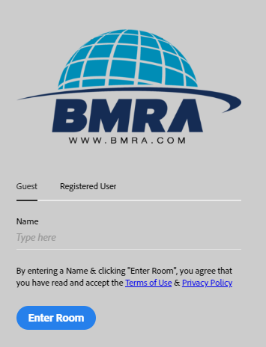
Join A Meeting
Access the course room by selecting the URL link provided to you prior to the start date
Enter your name when prompted
Please include your first and last name
Select “Enter Room”

Slide 4
Meeting Audio
At the top of the screen, you will see the course name and two icons that resemble a speaker and a microphone
If the icons are grey, that means they are off
If the icons are green, they are on
If the microphone icon is red, then you are muted
To test speakers and microphone:
Select course name then select speaker and microphone set up
Follow the instructions to test audio

Slide 5
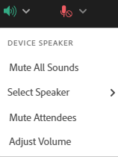
Speaker and Microphone Selection
To choose the speaker you would like to use:
Click speaker icon > select speaker
To choose the microphone you would like to use:
Click microphone icon > select microphone
To adjust the volume in the course:
Click speaker/microphone icon > adjust volume
To Mute/Unmute:
Click on the microphone icon until it is unmuted (green) or muted (red)

Slide 6
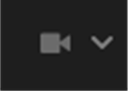
Web Camera
If the course requires web cameras:
Please ensure you have a working laptop or plug in camera
Select the webcam icon > Start My Webcam
A preview pod will appear and if you are happy with what is being shown, select “Start Sharing” to allow others to be able to see your image

Slide 7
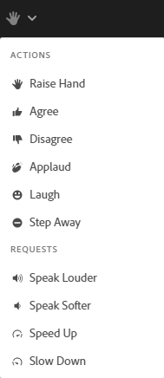
Change Your Status
Status will appear next to your name in the Attendees pod
To change your status:
Select the drop down arrow beside the hand icon and then pick any status you see fit
For example, if you have a question:
Select “Raise Hand” icon
To clear status, click the drop down arrow again and select “Clear Status”

Slide 8
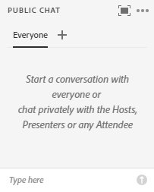
Chat Room
To send a public message to the class, type your message where it says “Type here” and hit enter to send
To send a private message, click on the “+” symbol and select who you would like to start a conversation with
Can be used to message the host privately
To customize chat bubble color or text size:
Select the three horizontal dots at the top right corner and then chat color or text size

Slide 9
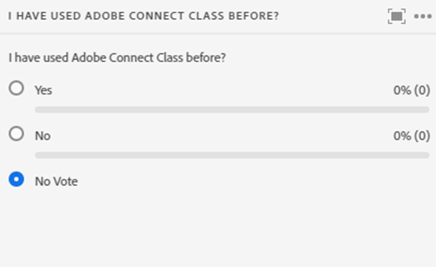
Polls
If an instructor decides to use a poll in the classroom, they will post it in the center of the room
Please select one of the listed options
You are able to change your answer until the poll has been closed
The results will update automatically as the rest of the class makes their choice

Slide 10
Student Materials
Under the course slides, you will see a pod titled “Student Materials”
Click the item listed in the pod and it will automatically pull up a SharePoint page in your web browser
Will contain folders with all the materials needed for the course

Slide 11
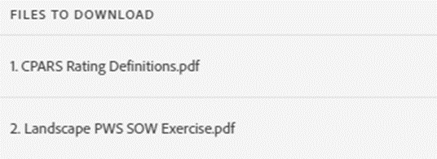
Additional Files
Some classes will have an additional files pod to the right of the student materials under the course slides
May be titled “Additional Handouts” or “Additional Files”
Hover over the document you would like to download and click on the download icon when it appears
The selected document will directly download to your computer

Slide 12
Web Links
Exams and Evaluations will be administered through web links
Additional items may be shared through links as well
A web link pod will be posted in the center of the classroom for everyone to access when necessary
Click the item listed in the pod and it will automatically pull up the link in your web browser

Slide 13
Resizing The Slides
To enlarge the slides on your device:
Select to three horizontal dots located at the top right corner of the slides and then click “Go full screen”
To minimize the slides, select the three horizontal dots again and then click “Exit full screen”

Slide 14
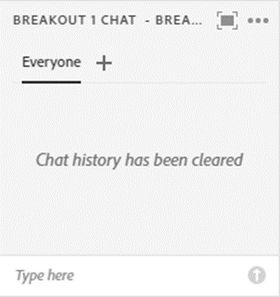
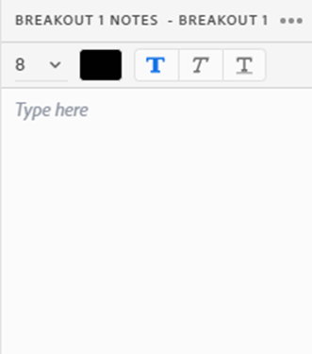
Breakouts
Breakouts are when students are divided into groups and sent to their own private rooms
Can manipulate items in the room and freely speak to their teammates
To message your team members, simply send a message in the pod labeled “Breakout # Chat”
To write notes in your room, directly type into the “Breakout # Notes” pod

Slide 15
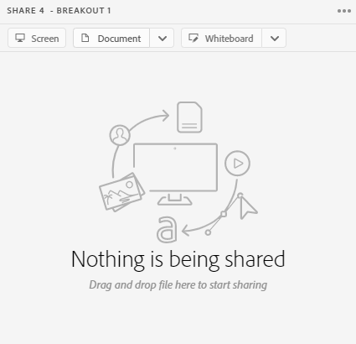
Breakouts (Cont’d)
To share your screen:
Select the screen button and what display you would like to share
Best to share your screen through the downloaded application
To upload a document:
Select the document button and upload a PDF or PPT (all other documents like Excel or Word need to be converted)
To draw up an image or note:
Select the whiteboard button which allows you to draw live

Slide 16
Troubleshooting
Let’s get to fixing!

Slide 17
“I Cannot Get Into The Meeting”
Tip #1
Make sure you have disconnected from the VPN! The VPN severely restricts bandwidth
Tip #2
Click the help link on the meeting login page. Test your connection by following the prompted steps
Tip #3
If using a web browser, make sure your flash player is enabled and popup blocking software is turned off

Slide 18
“I Cannot Hear Any Audio”
Tip #1
Make sure speakers are on and volume is turned up! The volume icon will glow green if on
Tip #2
Be sure to be off the VPN as it can cause audio connection issues
Tip #3
If idle for too long (like returning from lunch), refresh the classroom by logging off and back on

Slide 19
“My Audio Is Choppy”
Tip #1
Close out of other apps, so that Adobe Connect is the only one up and running! Having other apps open can restrict bandwidth
Tip #2
If using a web browser, try using the Adobe Connect desktop application instead
Tip #3
If you cannot be off of a VPN, download the Adobe Connect Mobile app to listen to the audio through there! Follow along on your laptop and be sure to mute your speakers on the laptop to avoid hearing an echo

Slide 20
“No One Can Hear Me”
Tip #1
Make sure your microphone is on and the correct one is selected! The microphone icon will glow green if on
Tip #2
Allow microphone access on your device! Be sure to run through the Speaker/Microphone Setup to test capabilities
Tip #3
Be sure to be off the VPN as it can cause audio connection issues

